Slide 1
Rider Trends
Presented By: Ethan Sim
Last Updated: 29th July 2021

Slide 2
Agenda
Purpose Statement
Executive Summary
Key Findings
Recommendations
Appendix

Slide 3
Purpose Statement
Determine differences in bike usage between annual members and casual riders.

Slide 4
Executive Summary
Key Findings:
Annual members take shorter, regular trips, while casual riders take longer, infrequent trips.
Annual members and casual riders exhibit no clear preference for bicycle type.
Trips taken by annual members are more geographically clustered than trips taken by casual riders.
Recommendation:
Cyclistic could increase the appeal of membership for casual riders by tweaking cost, convenience, and incentive.

Slide 5
Key Findings

Slide 6
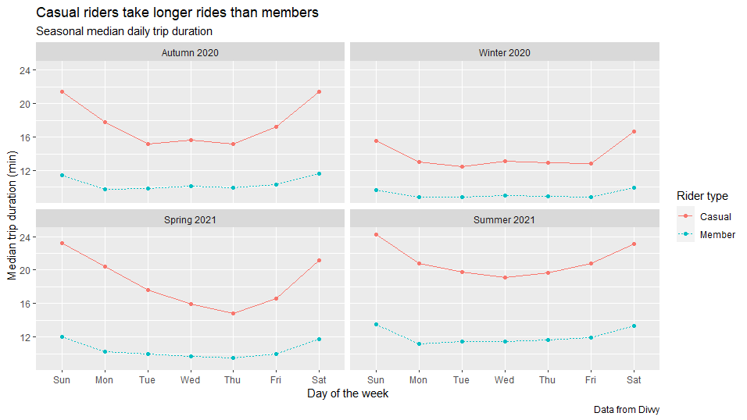
Duration
Both types of riders take longer trips on weekends
Both types of riders take shorter trips in colder seasons
Casual riders consistently take longer trips than members
Notes:
Median used here as a better indicator of central tendency than mean to avoid outlier skew and assumption of normality.

Slide 7
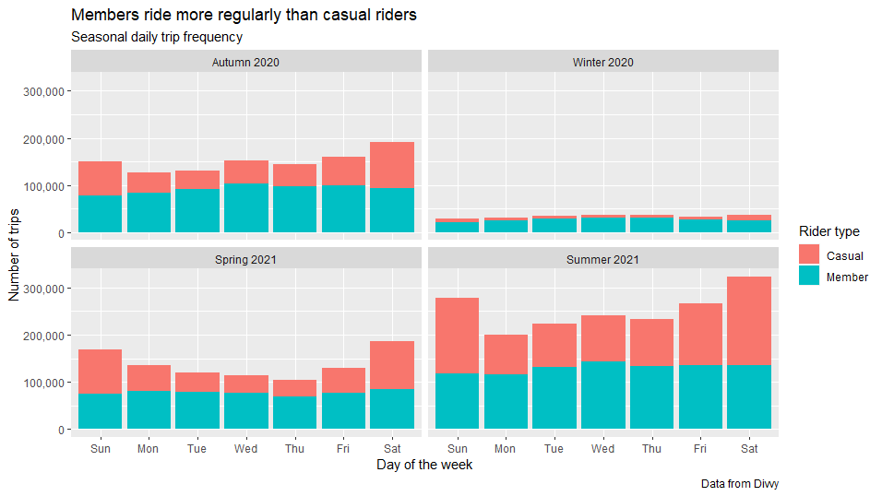
Frequency
Both types of riders take fewer trips in colder seasons
Casual riders ride more often on weekends, while members ride with roughly equal frequency across the week
Members ride more regularly than casual riders

Slide 8
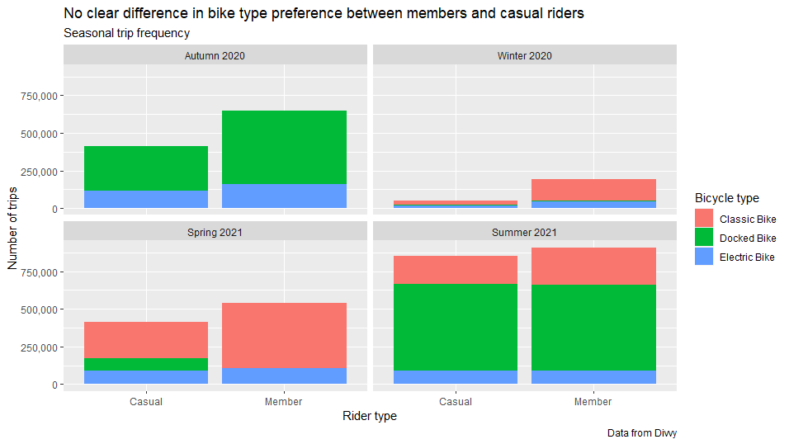
Bicycle Type
Both types of riders use fewer bicycles in colder seasons
Across all seasons, members use more bicycles, but proportions of bicycle type usage remain roughly similar
No clear difference in bicycle usage patterns

Slide 9
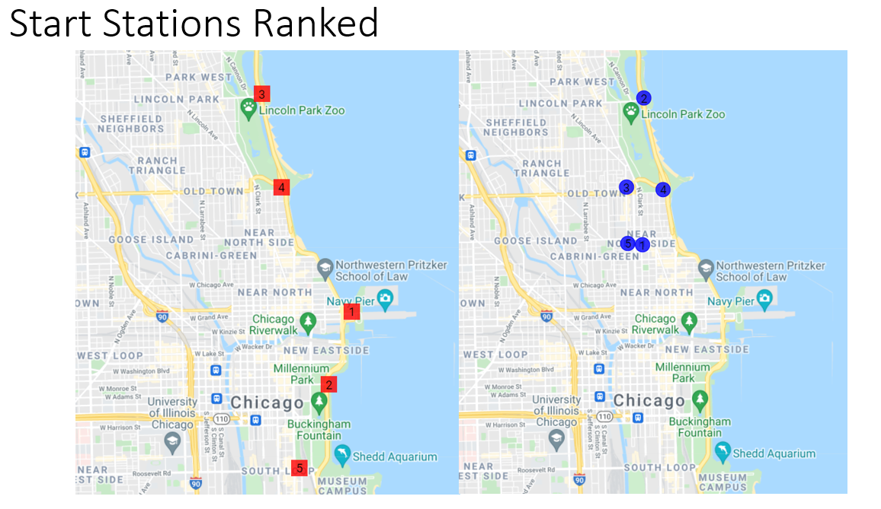
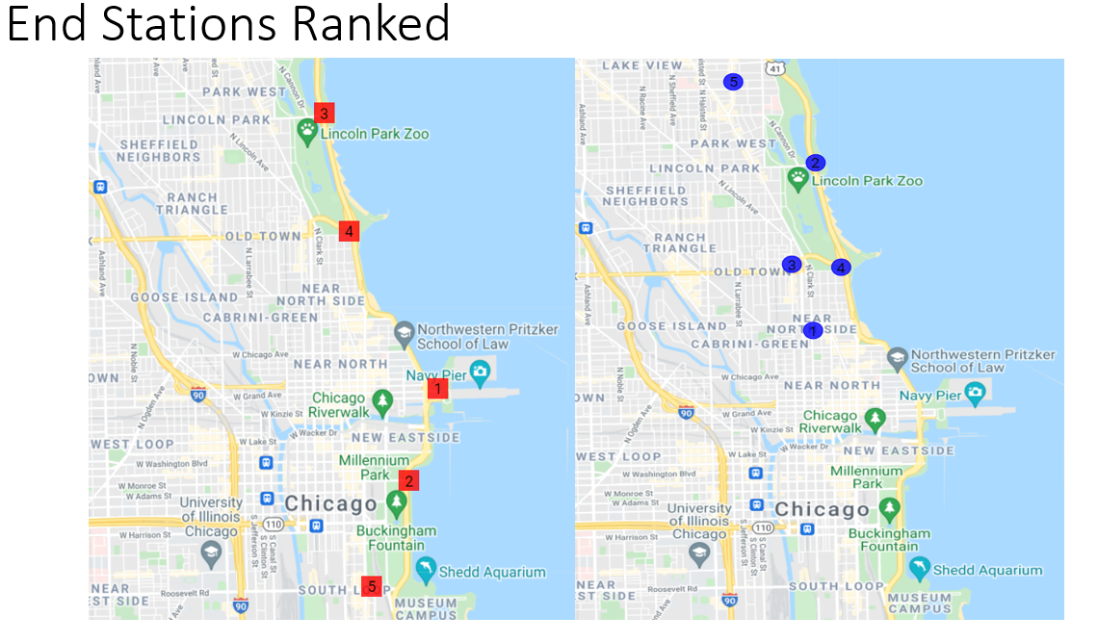
Geography
Casual rider traffic is spread out along the coast
Member traffic is clumped around Lincoln Park
Members exhibit greater geographical clustering

Slide 10
Limitations
Inability to track number of trips per rider
Many members each taking a few trips?
A few casual riders each taking many long trips per person?
Rationale for bicycle station position absent
Why attracts riders to each station?

Slide 11
Recommendations

Slide 12
Cost
Hypothesis:
Membership is too expensive for casual riders to justify regular usage
Data required:
Cost of membership and local public/private transport
Rider demographic data, e.g. age, address
Analysis next steps:
Local cost comparison between membership and public/private transport layered over Chicago map
Overlay rider demographic data and cost comparison to assess proportional cost to user

Slide 13
Convenience
Hypothesis:
Bicycles are not conveniently placed for casual riders to utilise frequently
Data required:
Chicago node data
Commercial, Educational, Residential
Rider flow modelling software
Only rudimentarily explored here via station ranks
Analysis next steps:
Correlate rider flow with node data and identify neglected nodes for future station placement

Slide 14
Incentive
Hypothesis:
There is no need for a membership for riders taking long, infrequent trips
Data required:
Member survey data
Why they joined/why they are leaving
Effect of current advertisements and promotions
Analysis next steps:
Assess effectiveness of promotions and advertisements on members, and target efforts towards new niche
E.g. Points system, longer-term membership at reduced yearly cost

Slide 15
Summary
Cyclistic could increase the appeal of membership for casual riders by tweaking cost, convenience, and incentive.

Slide 16
Appendix

Slide 17
Analytical Workflow
Data Source
Rider data from Jul 2020 – Jun 2021
https://divvy-tripdata.s3.amazonaws.com/index.html
Data used under the following license
https://www.divvybikes.com/system-data
Data cleaning
Removal of improper names, duplicates, empty rows, negative durations
Object class conversion
Data transformation
Determine day, week, month, season
Data visualisation
R
https://docs.google.com/document/d/1YK0HfSfs7F3v1dRUb3-O229VZ4ATuzrW4BnGzhlFoyA/edit?usp=sharing
GeoPlotter
https://mobisoftinfotech.com/tools/plot-multiple-points-on-map/
Notes:
Conceptual Overview: https://docs.google.com/document/d/1PDArkHHkoDrzbLWL4ahsLPCiiUJiNR5zOGYJqJ76LWQ/edit?usp=sharing

